Slide 1
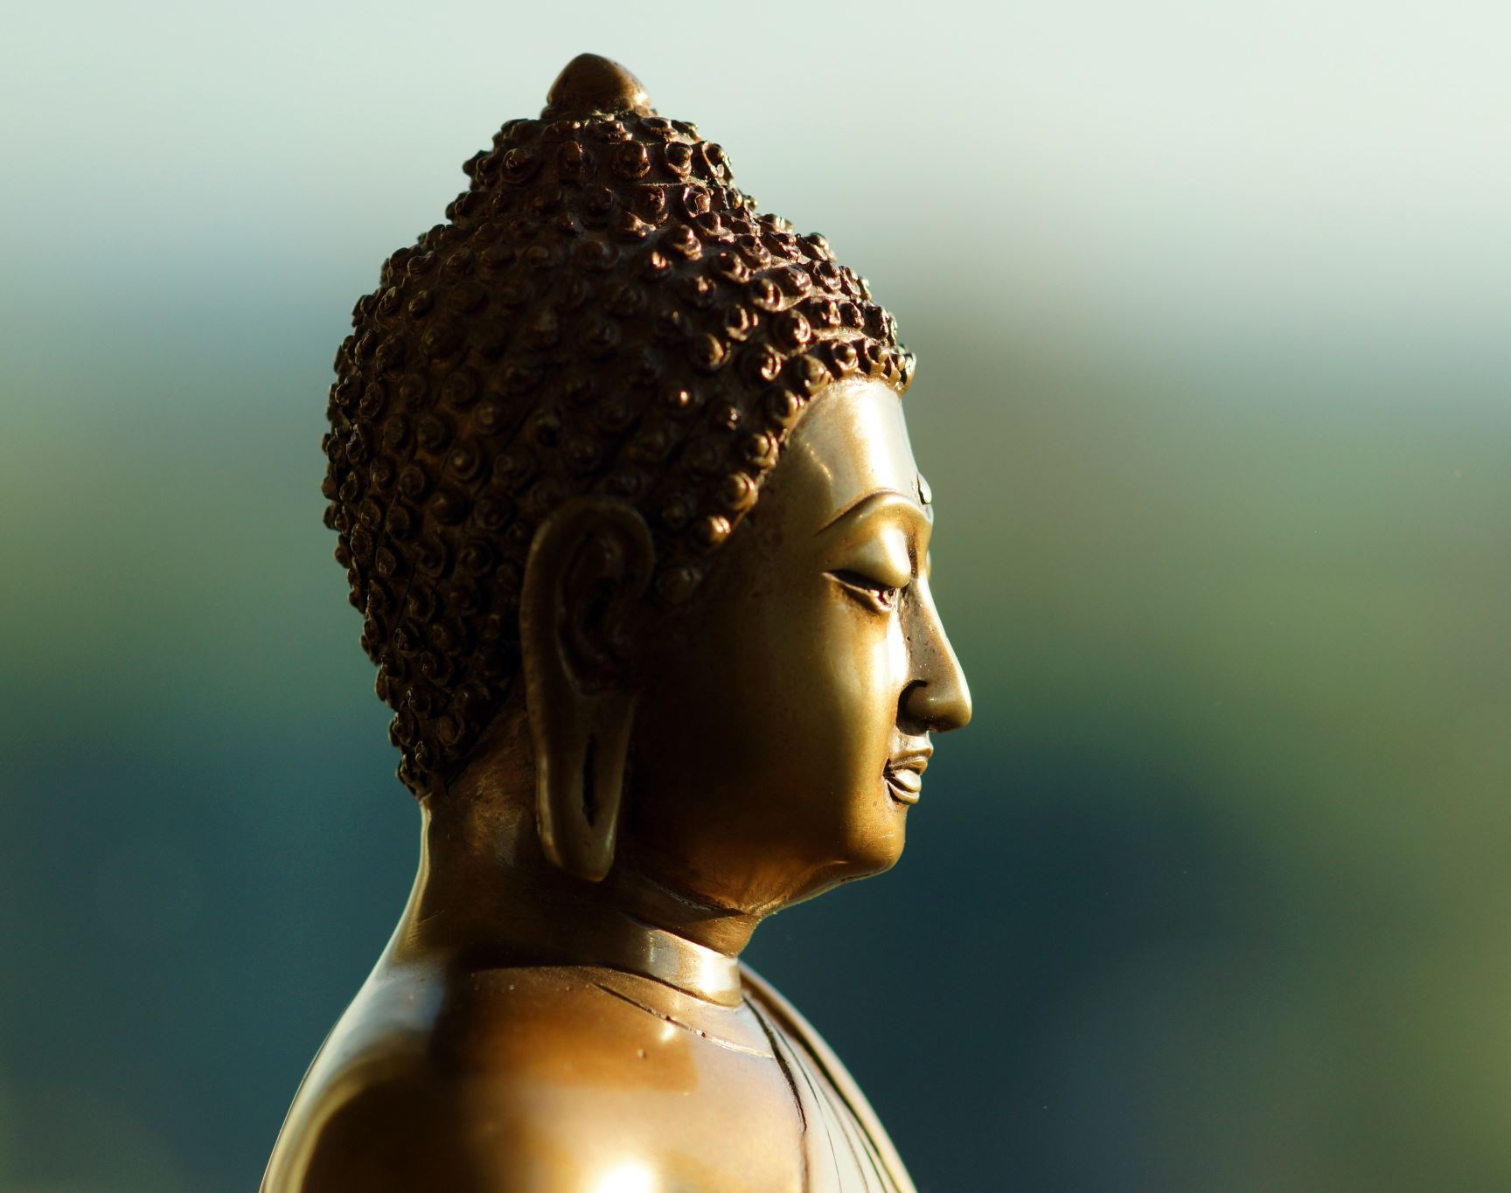
GAUTAM BUDHA SOCIETY FOR SOCIAL WELFARE
A CSR Initiative of India Expo Centre and Mart Greater Noida Uttar Pradesh

Slide 2
Society Introduction
Welcome to the Gautam Buddha Society The " Gautam Budha Society for Social Welfare " was registered on 30th April 2016. The main motto of the society is to promotes welfare activities in relation to sustainable and equitable development. And we run three educational institutions in Kasna, Sector 10 and Sector 17 Noida. And also going to organize health camps in these community.
we strive to promote peace, compassion, and mindfulness in our community. Our mission is to spread the teachings of Gautam Buddha and help individuals find inner peace and happiness through meditation and self-reflection.
Our society is dedicated to creating a supportive and inclusive environment for all members, regardless of their background or beliefs. We believe that by coming together and sharing our experiences, we can learn from each other and grow as individual

Slide 3
Members of Our Society
PRESIDENT- MR. O. P. MANCHANDA
TREASURER- MR. S. P. DADOO
GENERAL SECRETARY- DR. SANGEETA SHARMA DHAOR
MEMBER- MR. RAKESH GUPTA
MEMBER- MR. M. K. BANSAL
MEMBER- MR. TAFSIR AHMAD
MEMBER- MR. MANSOOR ANSARI

Slide 4
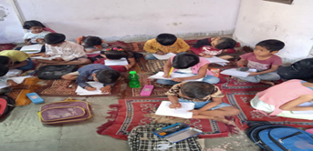
OUR EDUCATION CENTRE’S
We have Total Three Centres One in Greater noida in kasna Village and 2 centres in noida Sector 10 and , Sector 17.
1, Kasna Education Centre
Total Students : 34
2, Noida Education Sector 17
Total Students : 34
3, Noida Education Sector 10
Total Students : 34

Slide 5
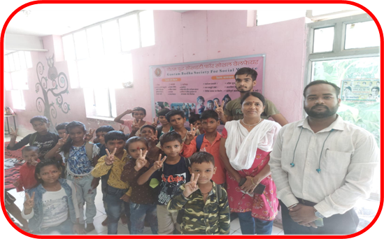
Our Education Centres
Locations-Noida, Uttar Pradesh
Kasna Village
Kasna is a popular village in Greater Noida, UP and has a population of approx two thousand children. Most of the families have migrated from West Bengal, Bihar, Uttaranchal and Orissa and live in jhuggi. Mostly people are employed in factories as labour and vegetable sellers or rickshaw pullers

Slide 6
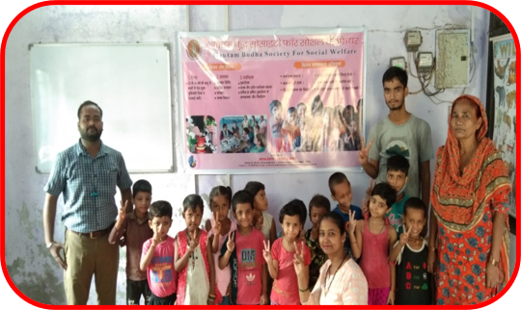
Our Education Centres
Locations-Noida, Uttar Pradesh
Sector 10​
In sector-10 Noida, Industries are Present where the surrounding population of these industries consist of factory workers, labours, rickshaw pullers and daily wage workers. As a result, many small children are found as rag pickers and labours working on daily wages because of lack of awareness about education. Therefore we mobilize the non-school going children. ​

Slide 7
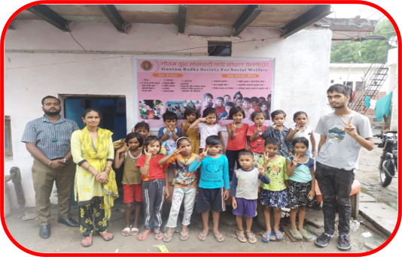
Our Education Centres
Locations-Noida, Uttar Pradesh
Sector 17
Sector 17 Noida, JJ Colony is an area which is a core slum belt. Mostly people living here are migrants from Bihar, West Bengal and orissa. Many students are found as rag pickers because there are no government and private schools in the sector. there for Gautam Budha Society for social Welfare came with an initiative to mobilize the non-school going children.

Slide 8
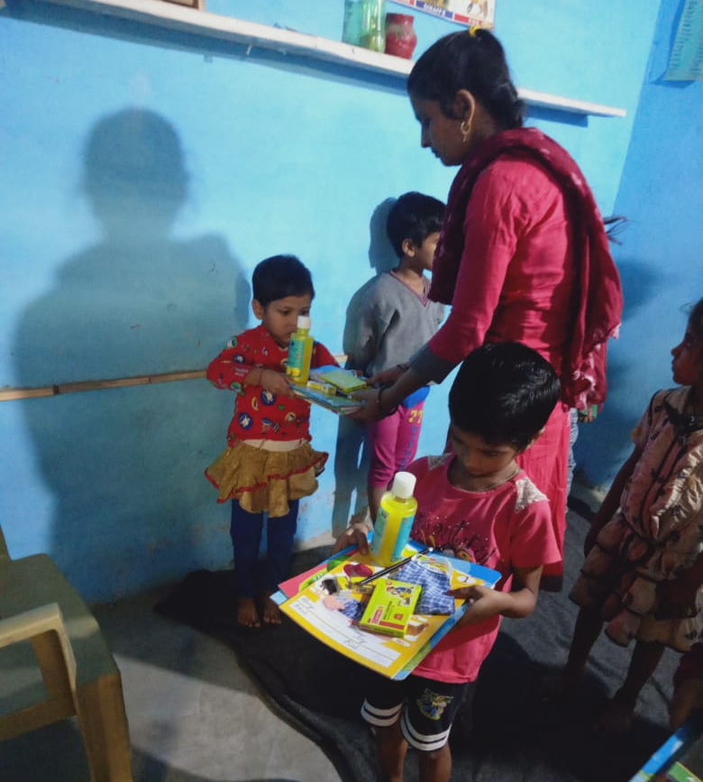
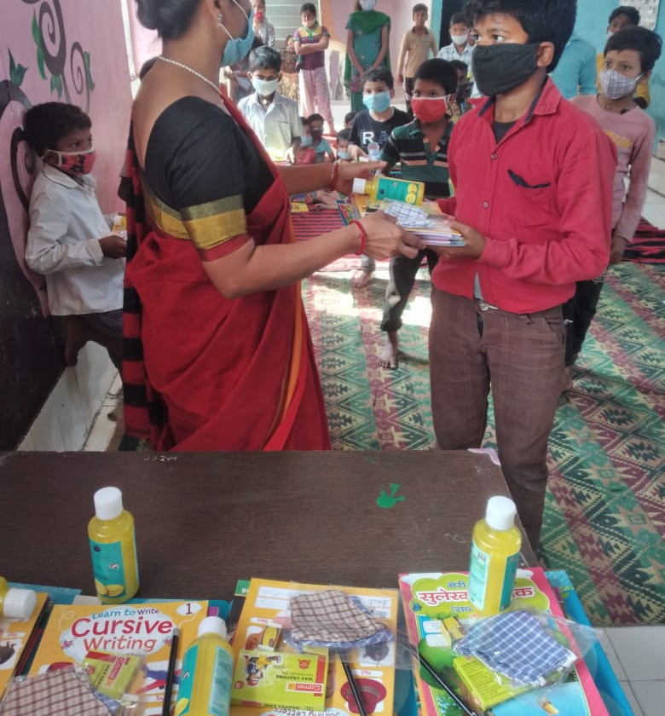
Due to the outbreak of COVID-19 pandemic, Gautam Buddha Society take the initiative and distributed stationary items, sanitizers and masks

Slide 9
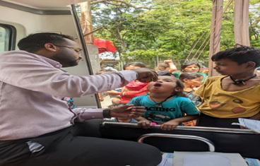
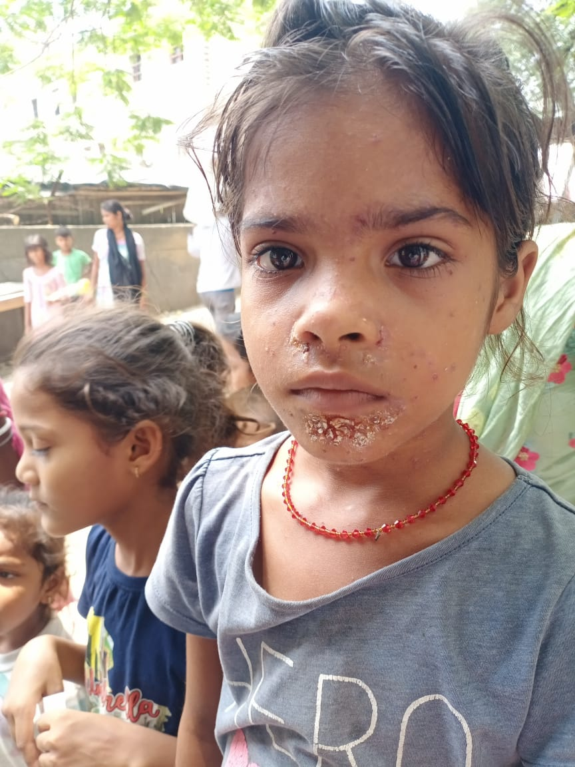
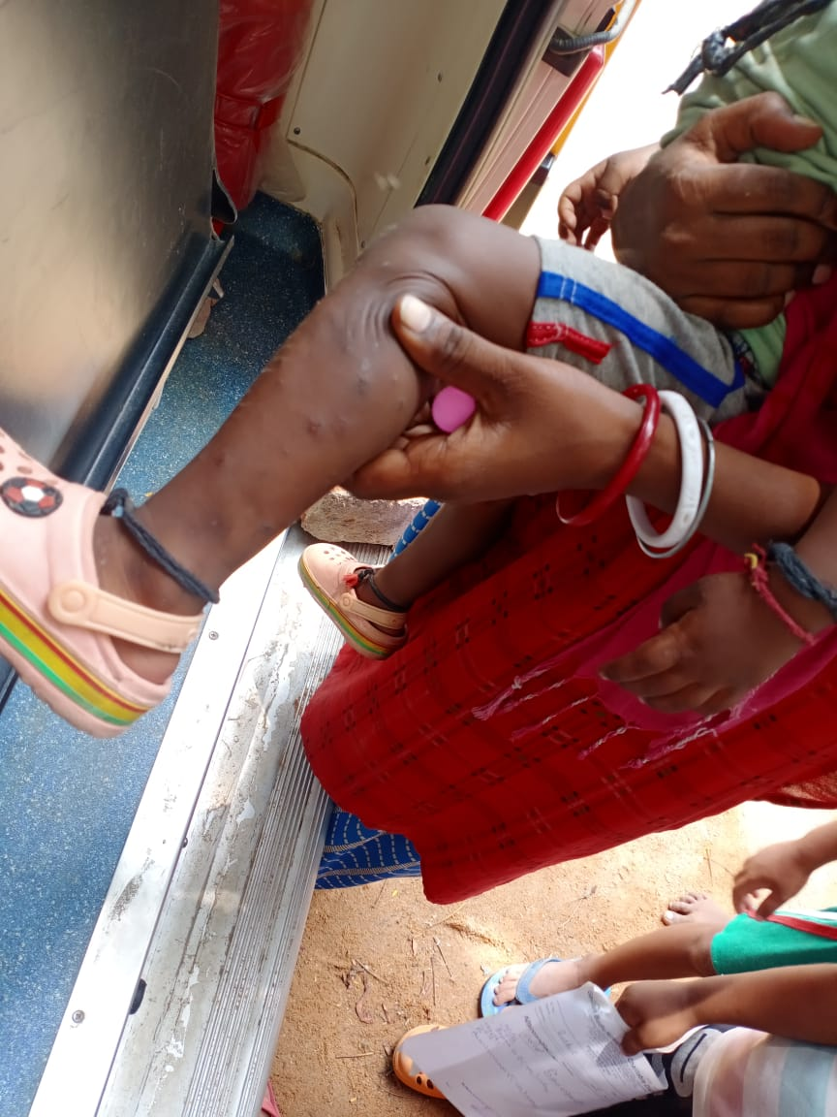
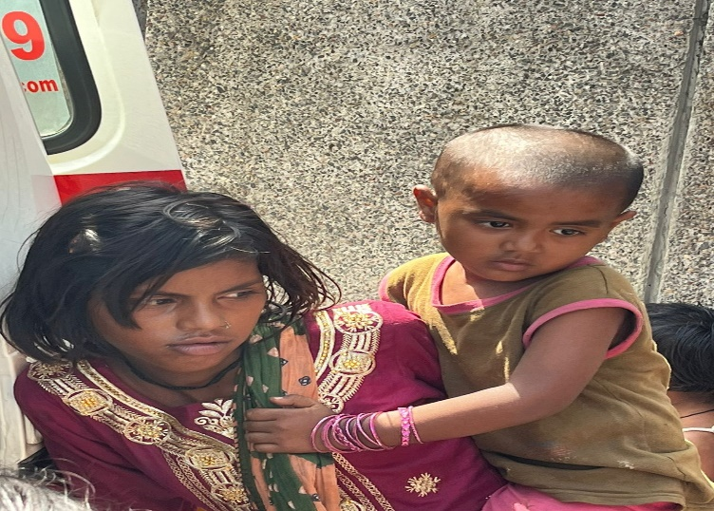
THREE MEDICAL CAMPS IN A WEEK WITH THE HELP OF DOCTOR AND STUDENTS
Continue Activity Every Wednesday & Friday
Approx 3000 Patients Check By Our Society Doctor

Slide 10
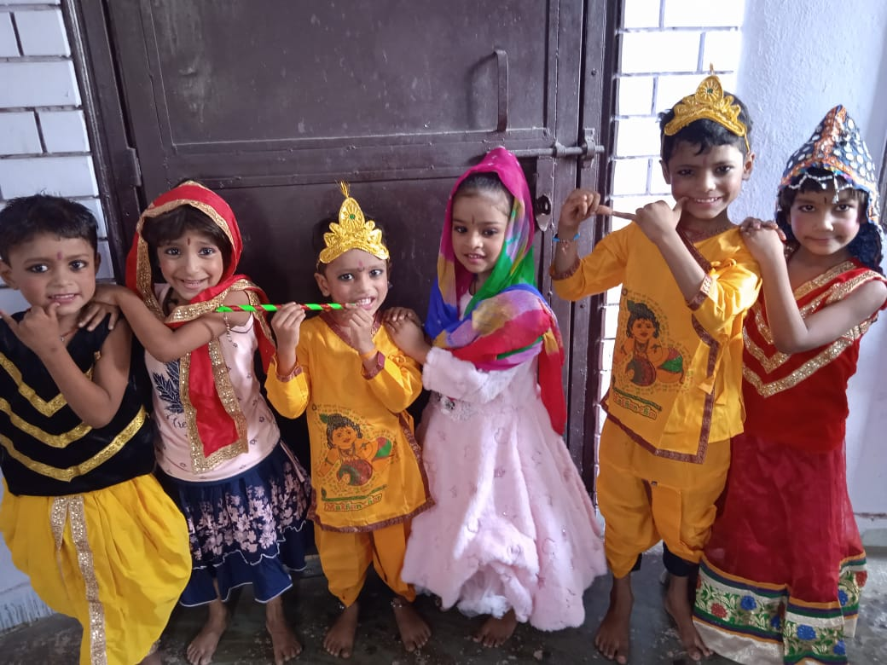
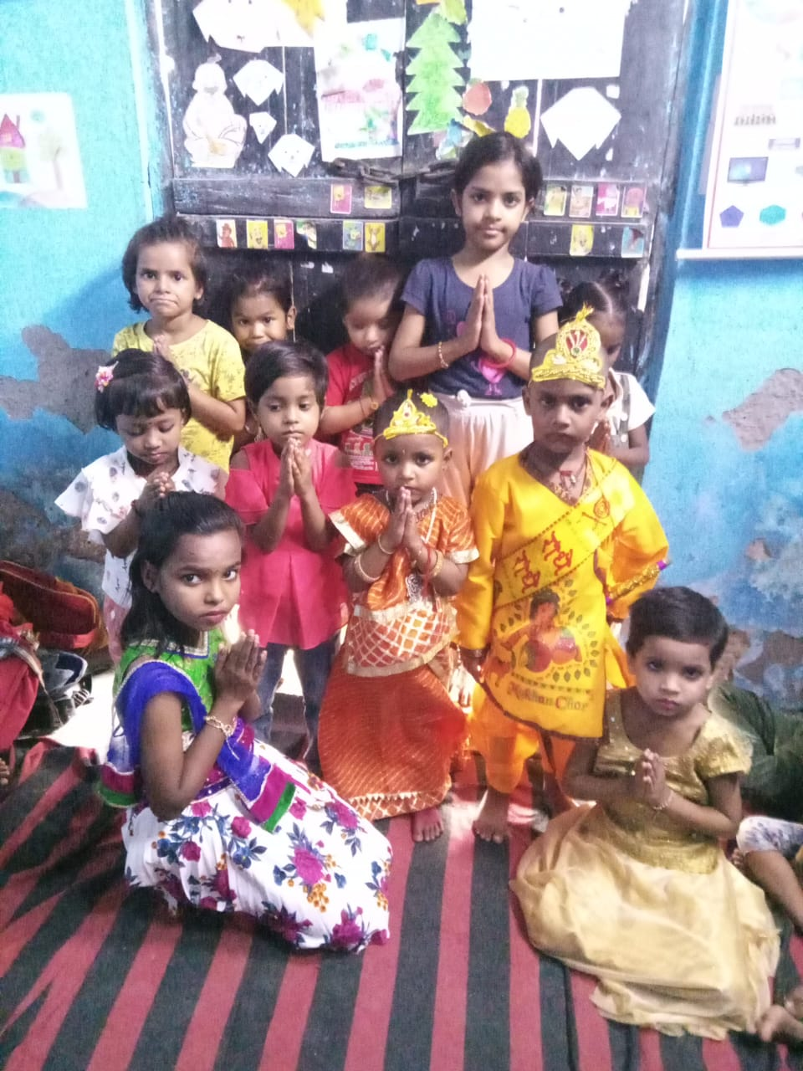
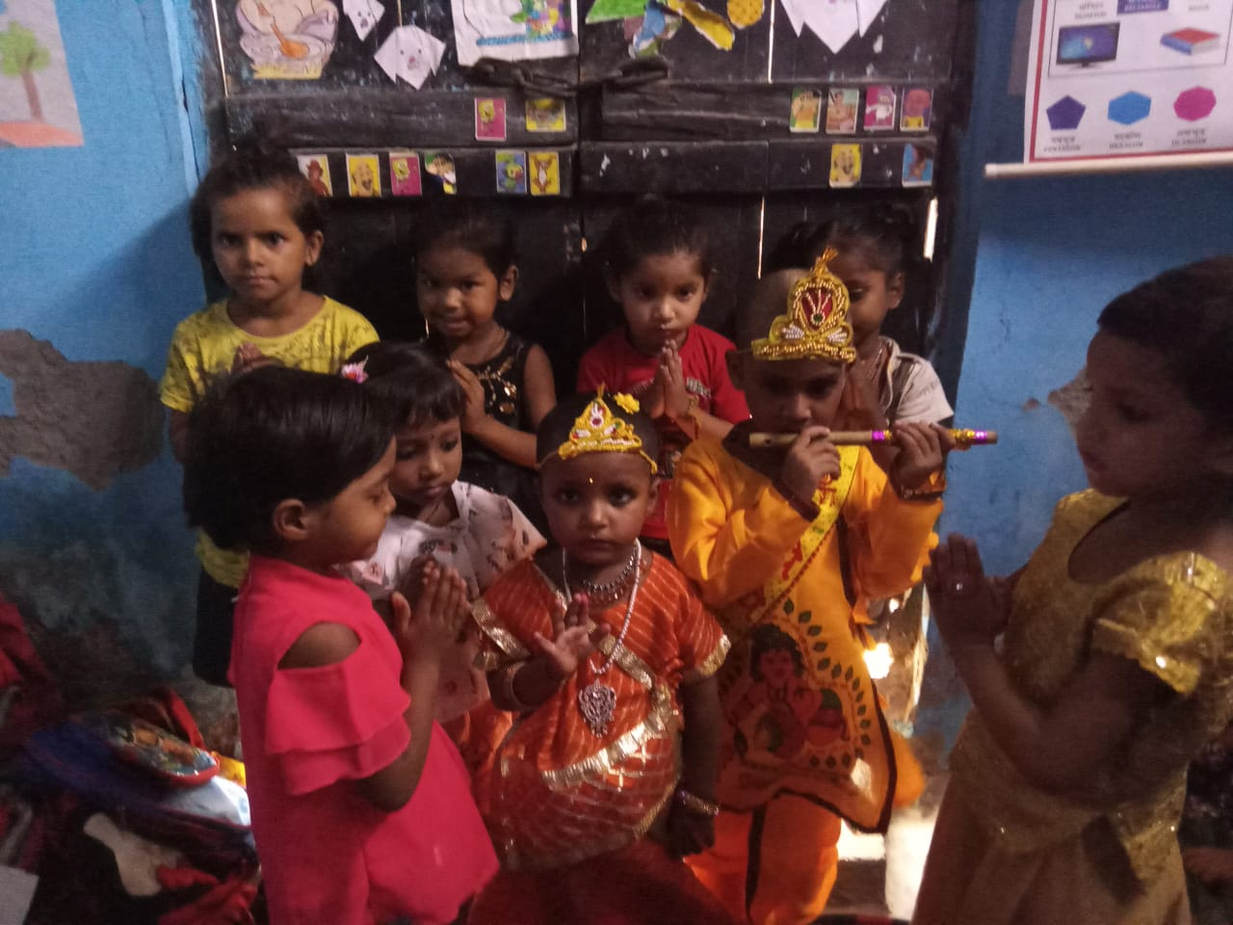
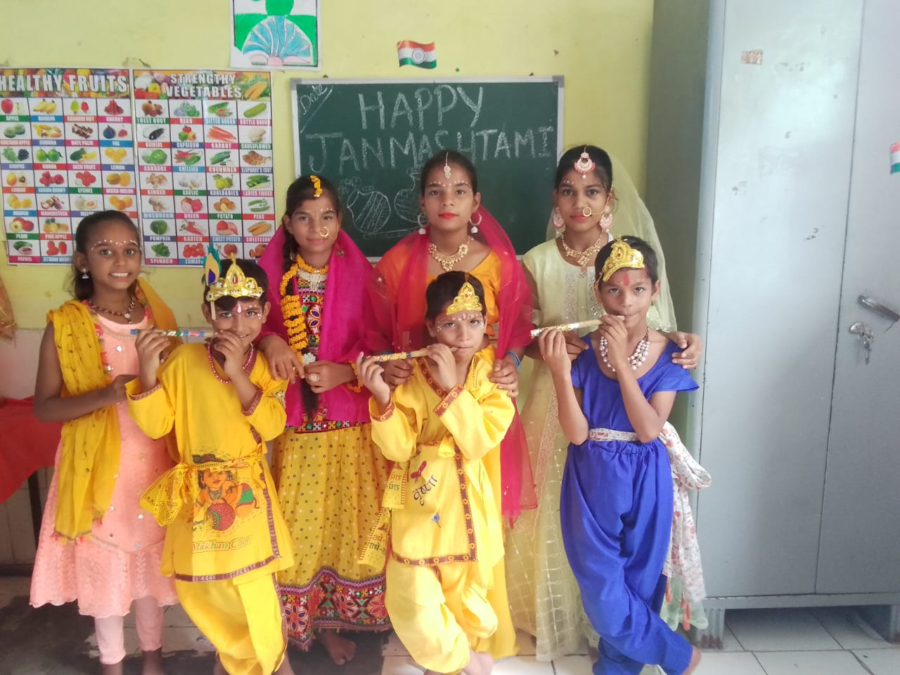
CO-CURRICULAR ACTIVITIES
Kasna Village, Greater Noida
Sector 10, Noida
Sector 17, Noida
Krishna Janmashtami

Slide 11
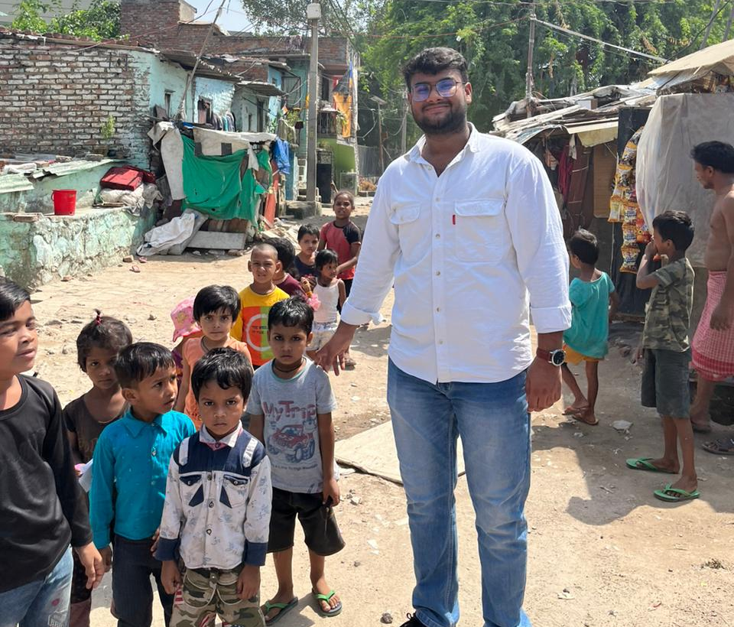
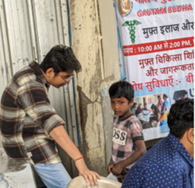
SOCIAL CASE STUDY BY SOCIAL WORK STUDENT OF UNIVERSITY OF DELHI​
Social Case Work, a primary method of social work is concerned with the adjustment and development of the individual towards more satisfying human relations. Social casework is one-to-one relationships which works in helping the individual for his adjustment and development. The process of social casework involves the study of individual problem in its total setting. Social case work is required because every individual is unique and his/her needs are different from other. In other words, treatment or intervention must be differentiated according to the needs of the individual. That is why, the case work method has been introduced.

Slide 12
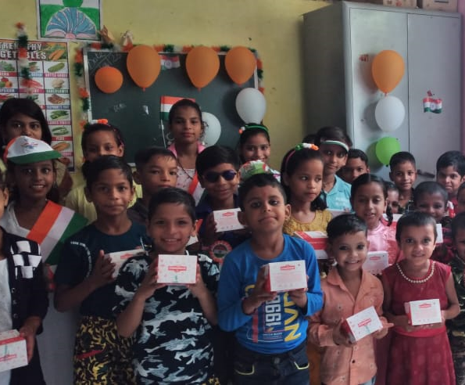
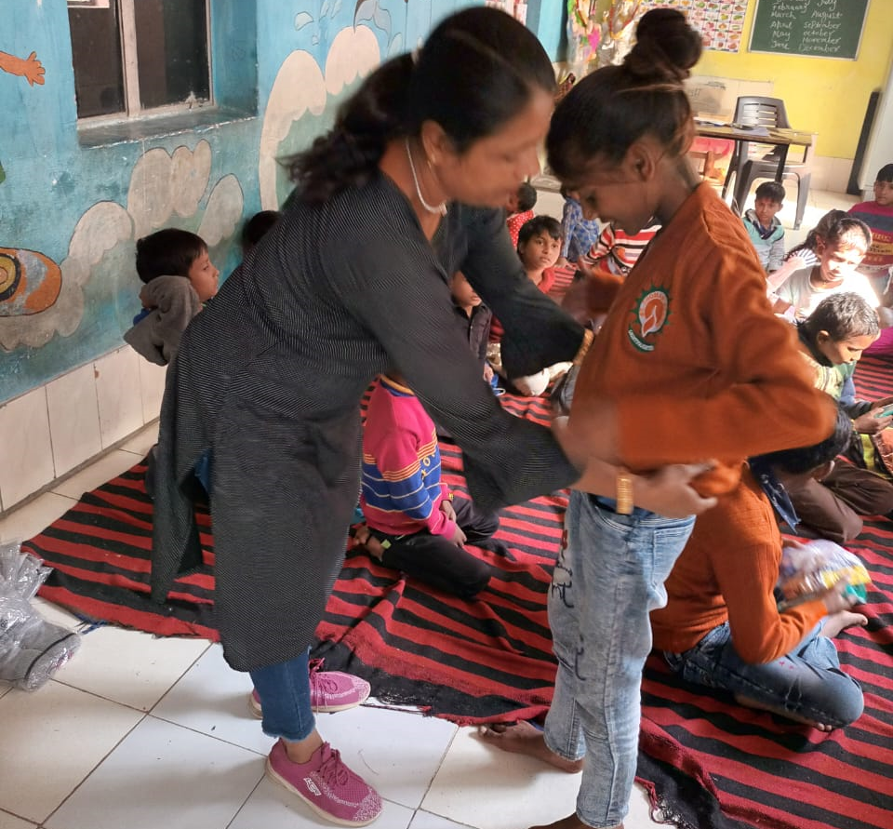
CLOTHS, SNACKS AND STATIONARY DISTRIBUTION

Slide 13
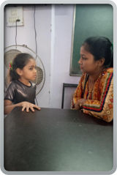
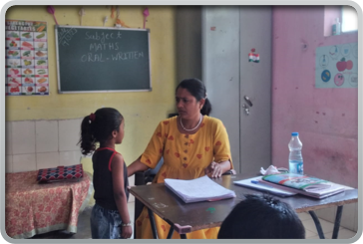
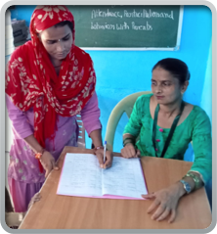
PARENTS TEACHER MEETING: EVERY 4TH SATURDAY

Slide 14
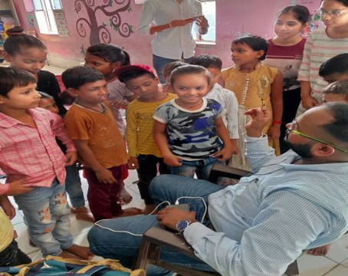
CHILDREN’S DAY CELEBRATION

Slide 15
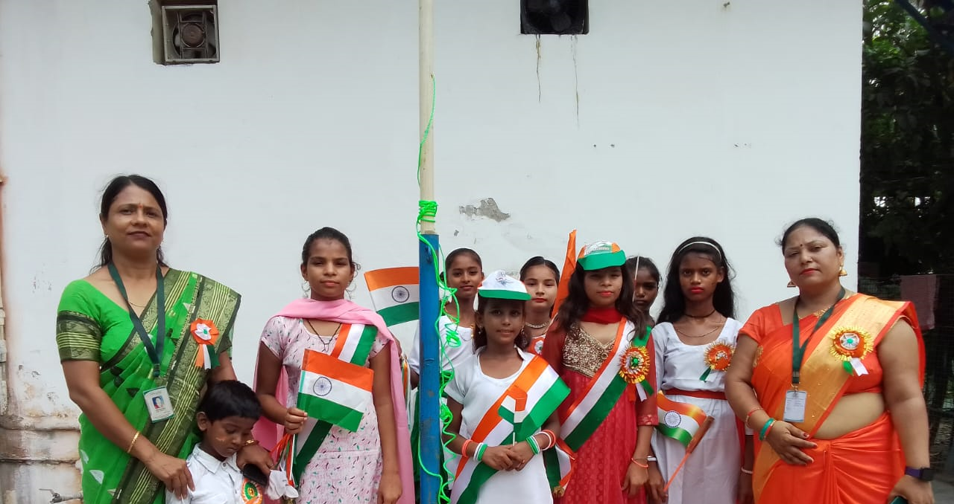
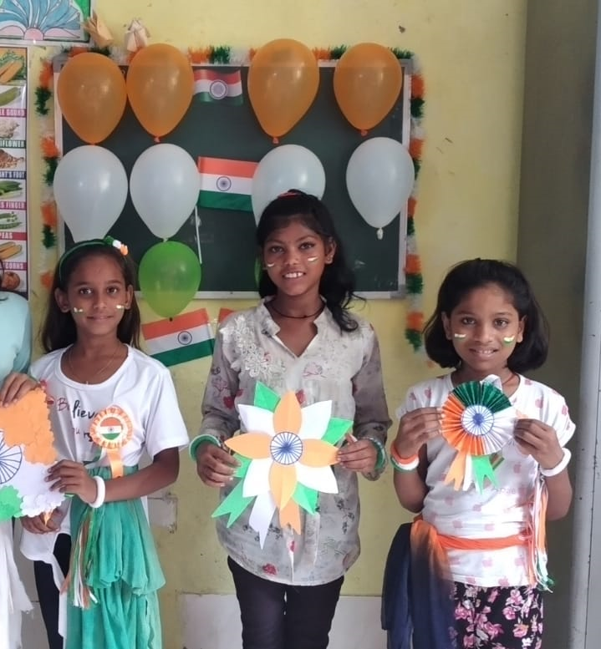
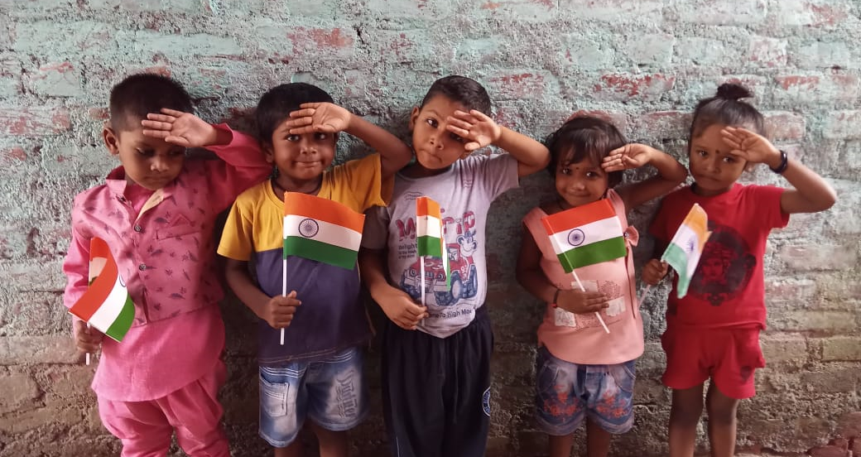
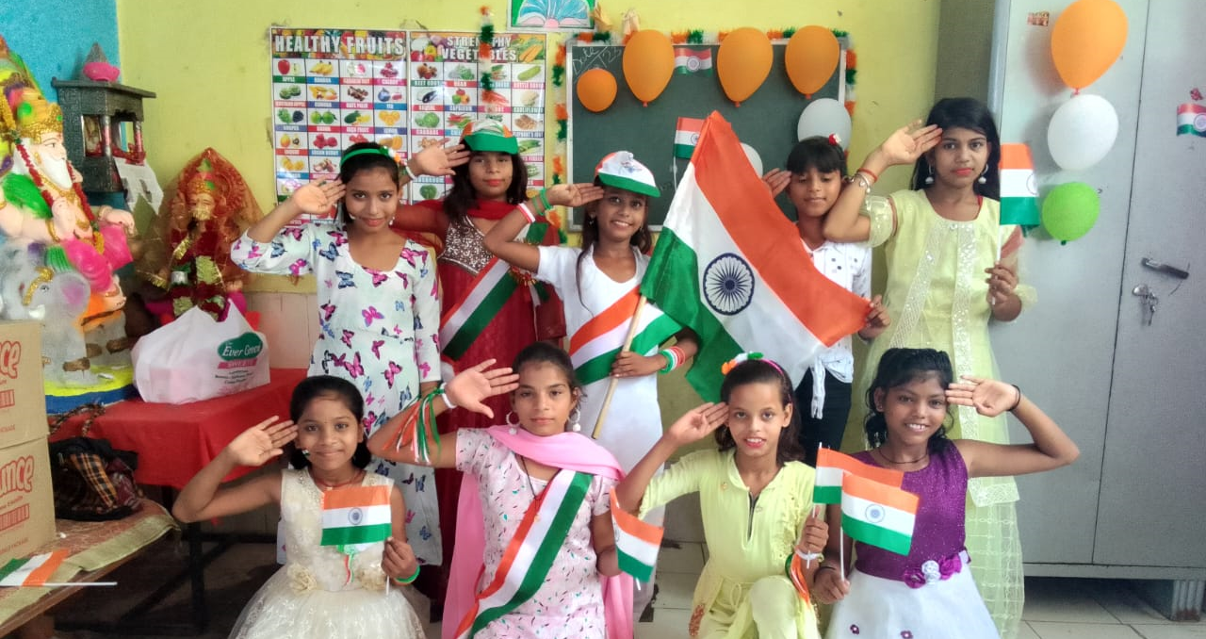
INDEPENDENCE DAY

Slide 16
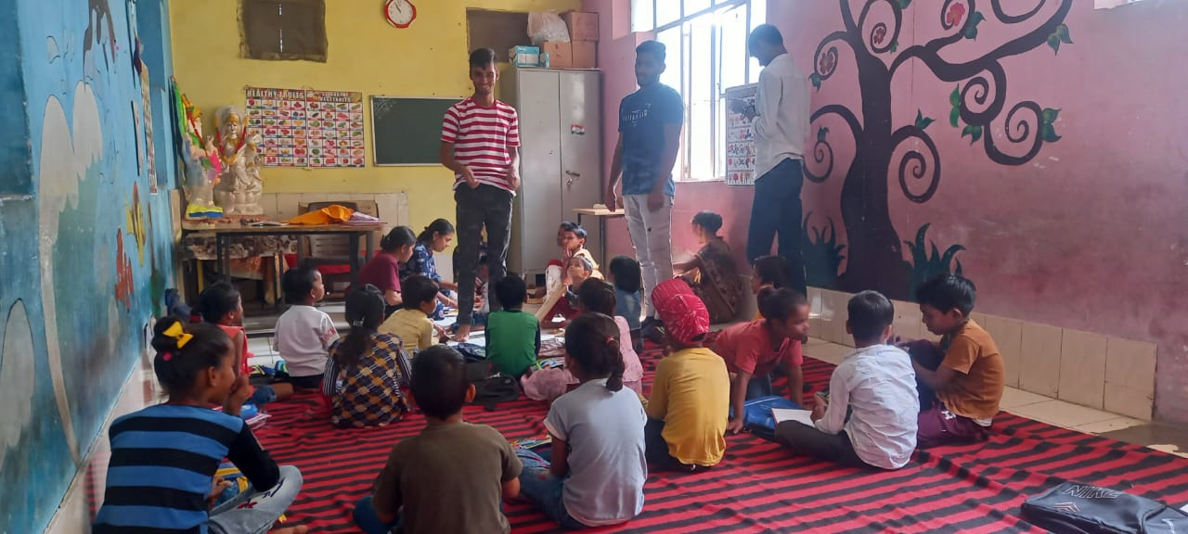
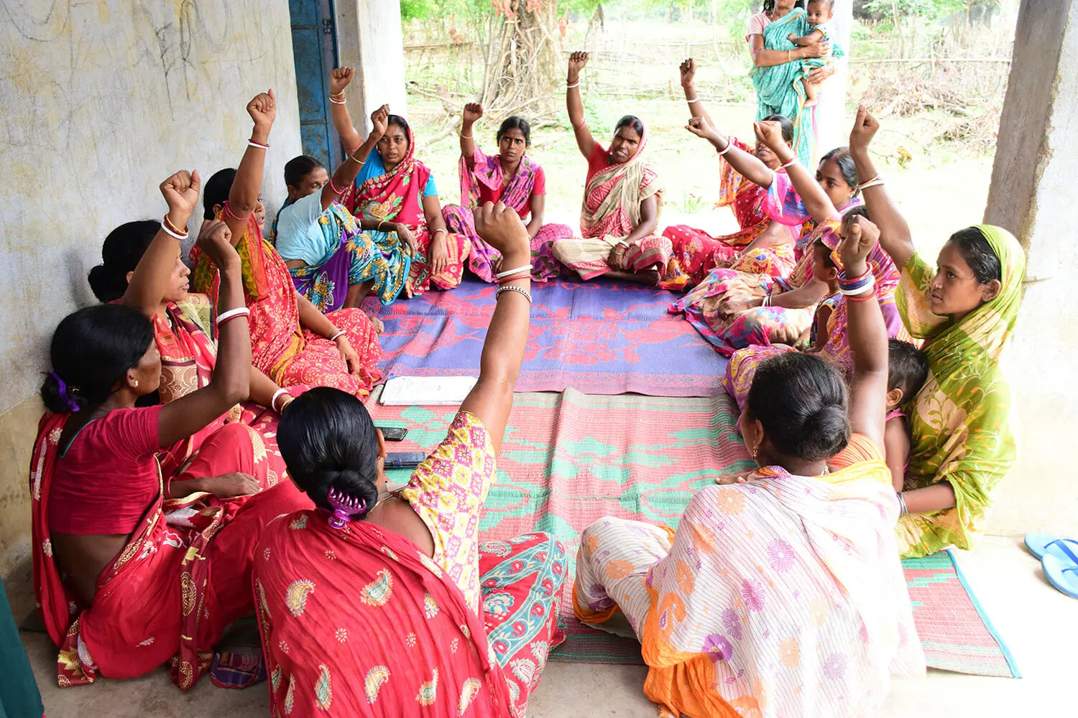
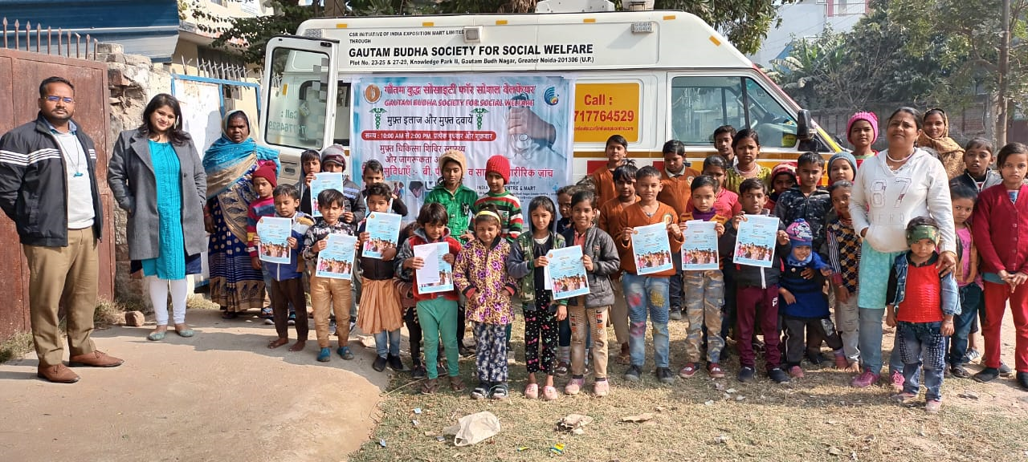
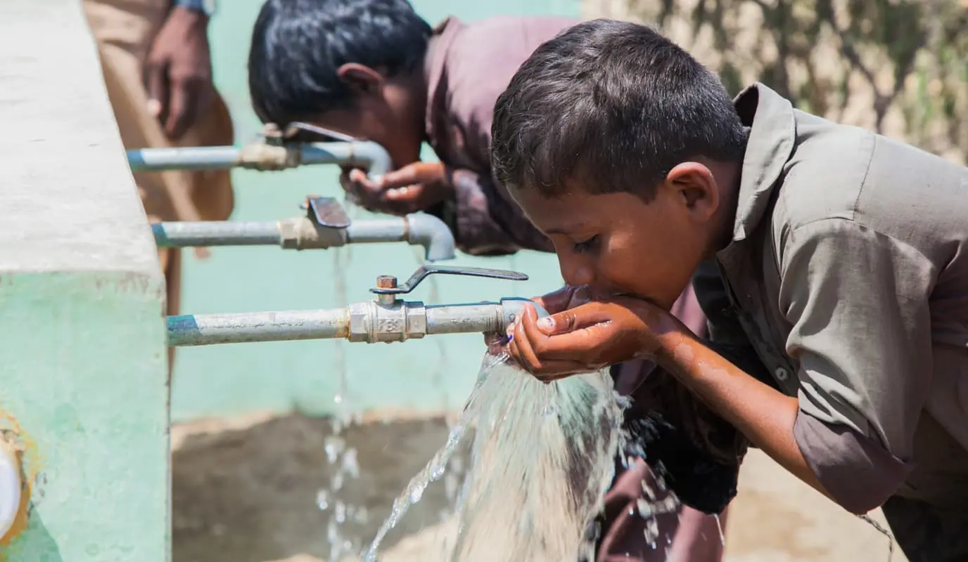
JOURNEY FOR GAUTAM BUDHA SOCIETY FOR SOCIAL WELFARE
Group formed with consent of corporate and institutions present under four themes
Education & Skill Development
Women Empowerment & Sanitation​
Preventive Healthcare & Malnutrition​
Environment Sustainability & Clean Water​

Slide 17
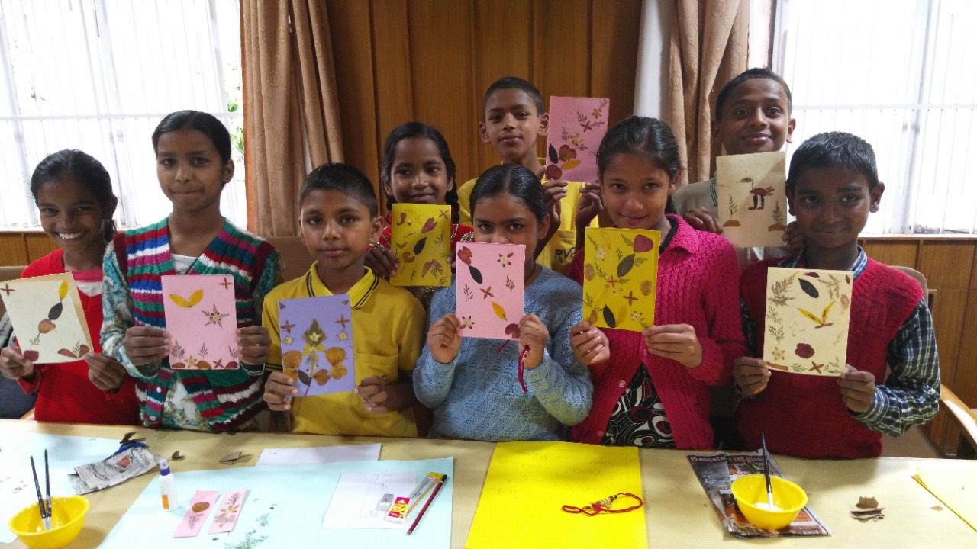
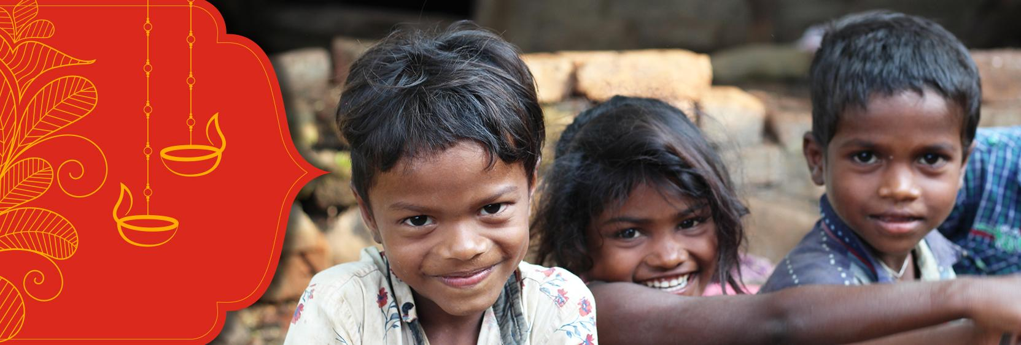
DIWALI CELEBRATION

Slide 18
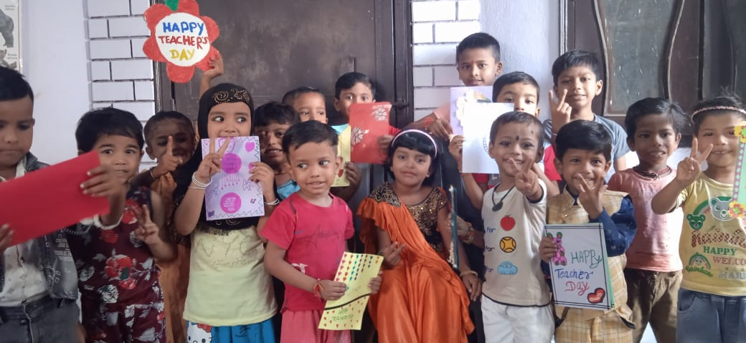
TEACHER’S DAY CELEBRATION

Slide 19
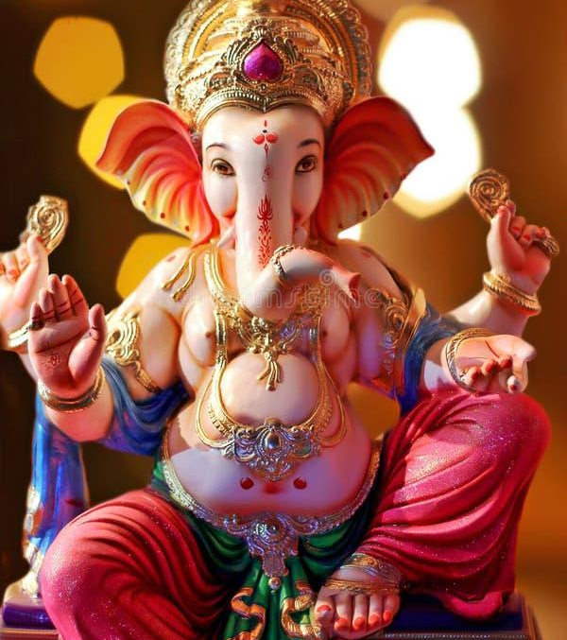
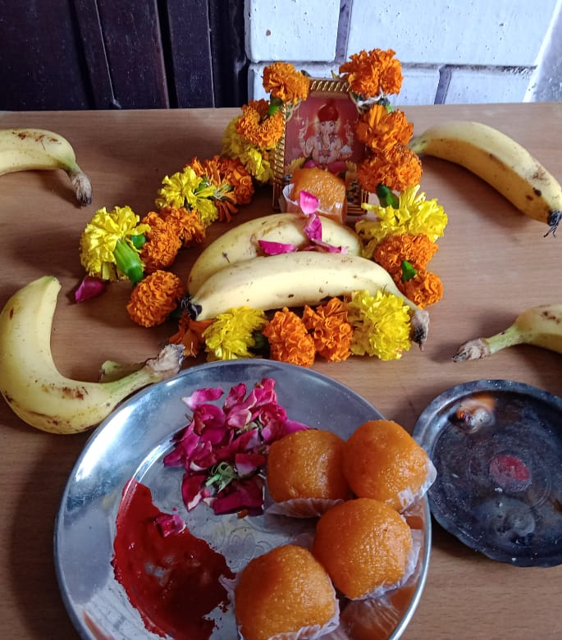
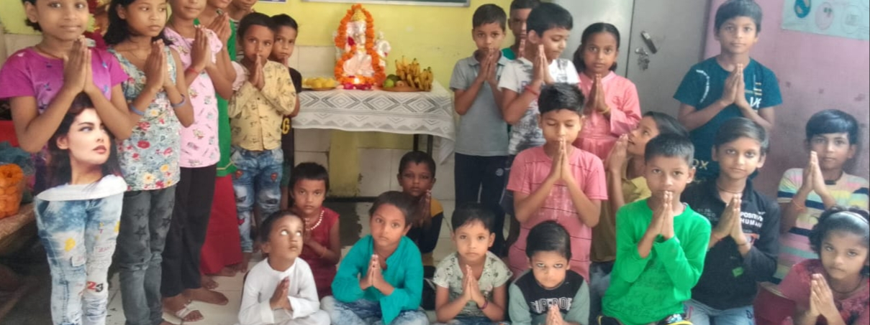
GANESH CHATURTHI

Slide 20
WORK DONE BY GBSSW TEAM:-
TEAM MEMBERS:-
Team lead and manage:- Mr. Aditya (CSR coordinator)
Consulted by:- Dr. Priyanka Shrivastav
Interns:- Nashrah Ali Siddiqui, Muskaan Sharma and Mohd. Shad Qureshi
Assistant work done by:- Mr. Lalit Kumar

Slide 21
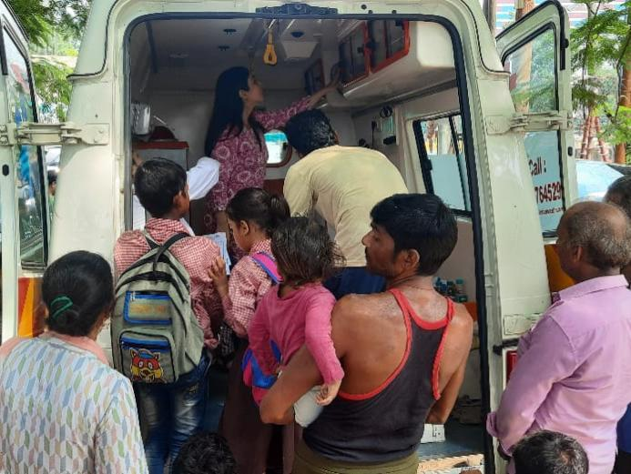
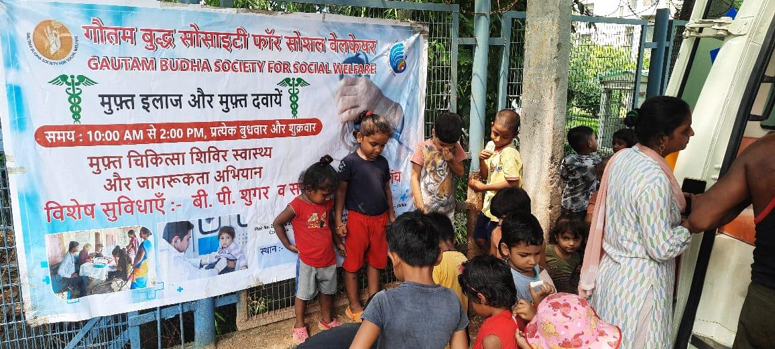
September 13,2023
To do a centre visit and provide the people there with homoeopathic treatment and medicines .
To do a check up for the previous patients that the doctor gave treatment earlier
We provided consultation to 60 people in total both the children and their parents.

Slide 22
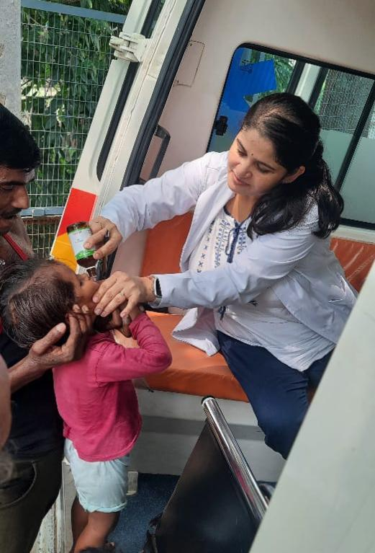
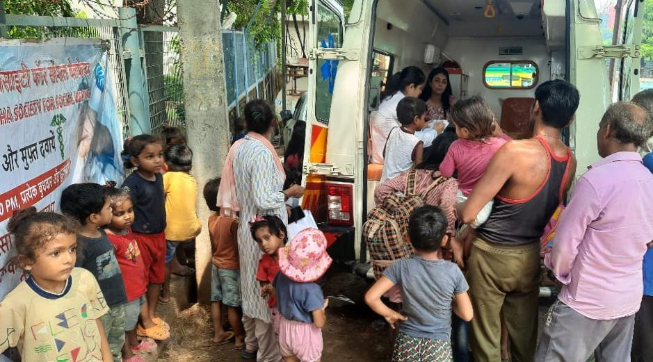
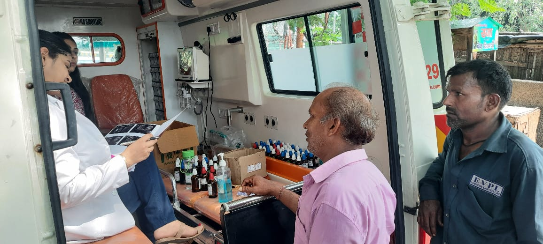
The following cases were covered by the doctor-
Fever
Stomach-ache
Ear pain
Dermatitis
Diarrhoea
Cervical spondylitis
Skin condition

Slide 23
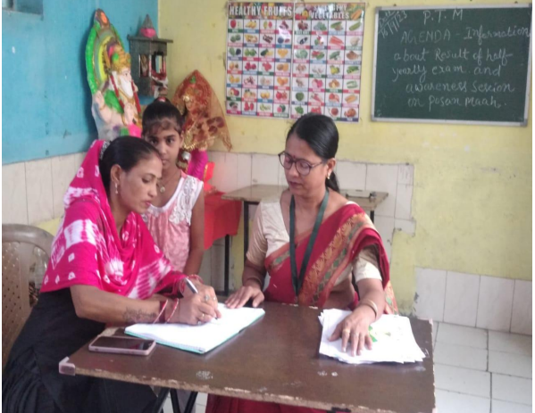
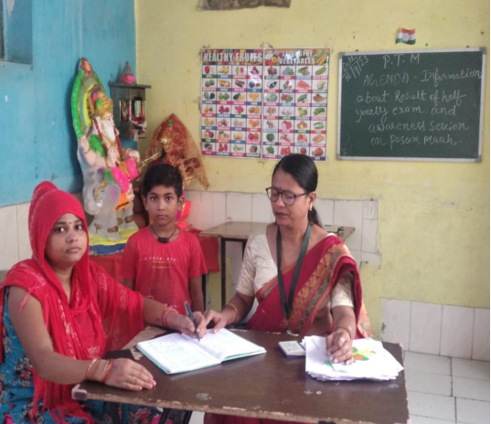
September 16, 2023
Visited to Kasna Education Centre for PTM.
A Parent Teacher Meeting (PTM) was conducted in the village of Kasna at Kasna Education Centre.The GBSSW team including visited Kasna Education Centre and interacted with Mansi ma’am.

Slide 24
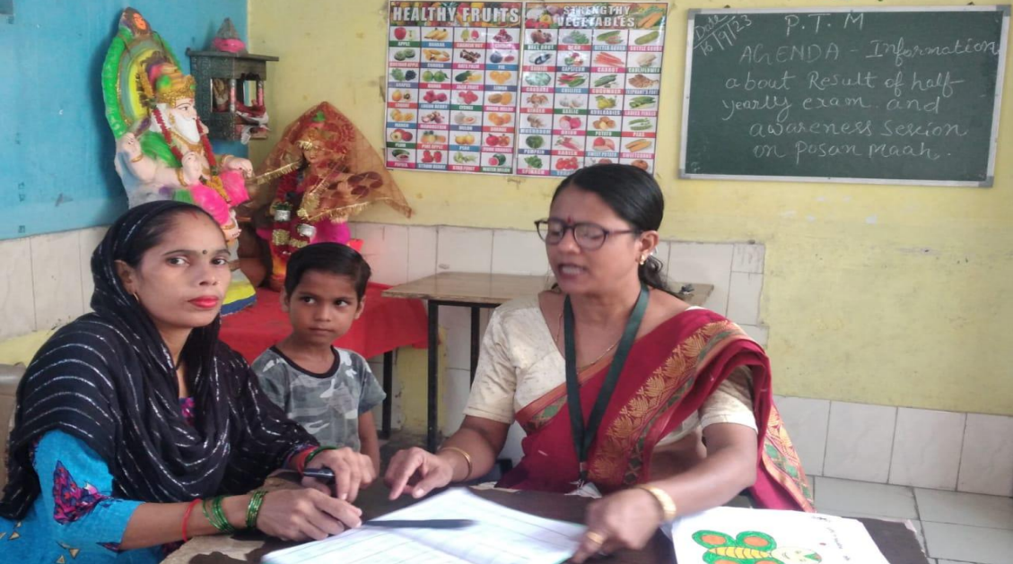
The meeting takes place on 4th Saturday every month in which the participation of almost all children's parents were noticed including mothers, father, and elder siblings who are daily wage workers living in the sum area of Kasna village itself. The meetingwas attended by the teacher who had adiscussion with parents about their child's progress in education.

Slide 25
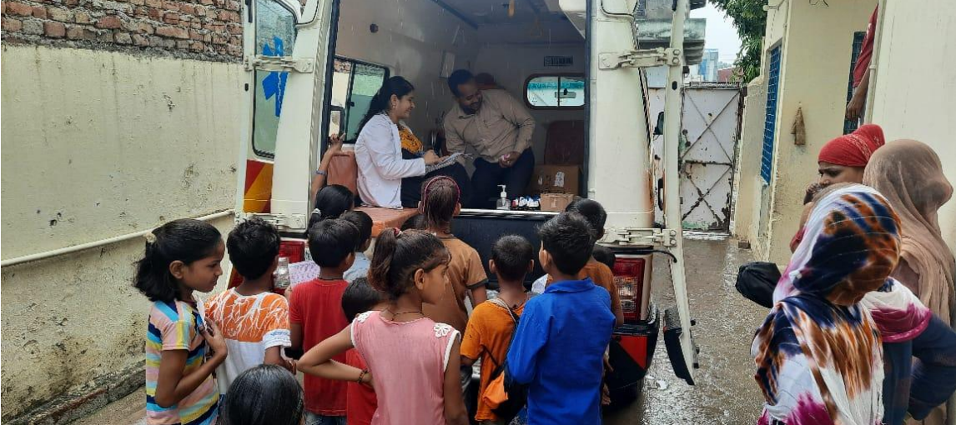
Conducted the Homeopathy Medical Camp at Kasna Village
A Homeopathy Medical Camp was organised by the stakeholders of Gautam Budha Society for Social Welfare with the community members of Kasna Village, Greater Noida.
Initially, the team was engaged in setting up the ambulance and necessary stuff like banners, Registers, Medicines etc.

Slide 26
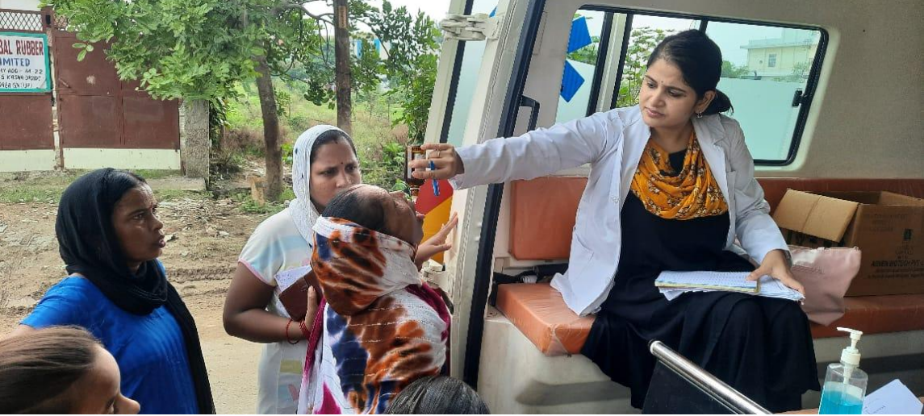
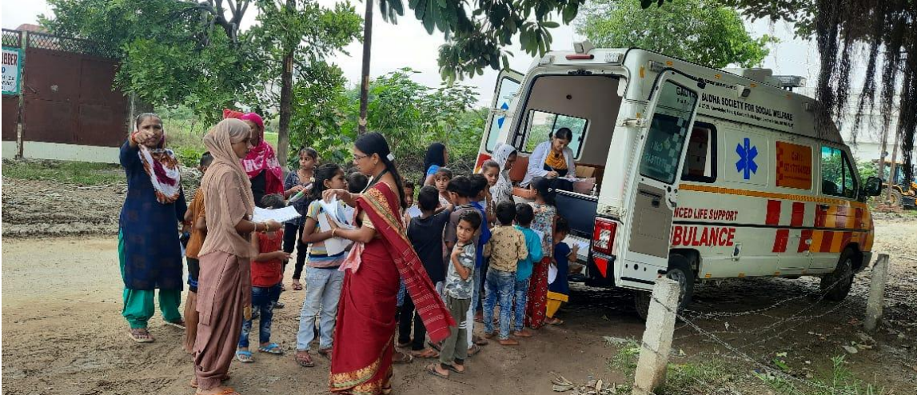
Soon enough, the crowd started to gather and Dr. Priyanka attended the patients one by one. The Medical conditions that were observed throughout the camp such as Fever, Stomach ache, Ear Pain, Dermatitis, and Skin related issues.
Also, Many people with their follow ups reached the Ambulance to continue their treatment. Approx 75 cases were undertaken at Medical Camp.

Slide 27
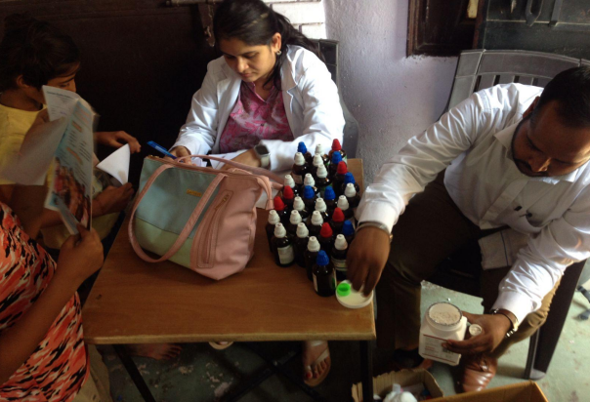
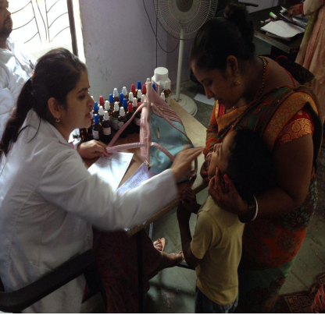
September 20,2023
Organized Medical Camp with the community of Noida Sector 10
During the medical camp , homeopathic medicines were provided according to the health issues of the community members such as Ear Pain, Stomach Ache, skin infection.

Slide 28
Interns conducted a Recreational activity session with children.
The session was conducted by trainees so that children would involve themselves and get the opportunity to show their talent. In this session, interns made some chits on which some activities were written. For Example:- Singing, Dancing, Acting etc….

Slide 29
Children were asked to sit in a circle and one of the intern was holding the chits and those chits had to be picked by children one by one and they needed to perform a task or activity mentioned in the chit.

Slide 30
September 27, 2023
Organized Health Camp for Marginalized people.
A Health Camp was organized by the team of Gautam Buddha Society for Social Welfare near the slum area of Noida sector 17.
It is a Mobile Medical Van of GBSSW which moves around Delhi NCR to organize medical camps for marginalized people. In that medical camp, homeopathic medicines are provided to the people of the community according to their health issues.

Slide 31
The vans visit such communities twice a week which is Wednesday and Friday. The Van of GBSSW provides a platform to marginalized people of the community to access the most important resources that is Medication for Health and Wellbeing.

Slide 32
Visited Community and Interacted with Children at Education Centre
The members of Society also visited the community in which the Education Centre is located. The interns interacted with the children and broke the ice through introduction and recitation of poems and their wellbeing.
The children who come there to study reside in the same slum area with their parents who work as a laborer on daily wages.

Slide 33
Critical Reflections
Every coin has two faces similarly every society has two sides, one which has all the facilities available and the other side which is ignored by everyone. GBSSW is working for that section of society and providing all the possible resources to people of that community.
Resources in terms of Health and Education.
For Health there is a mobile health van through
which Health camps are organized around slum
areas of Delhi NCR although for Education
GBSSW has established educational centres in
slum areas for providing education to the children of that community

Slide 34
September 30, 2023
Conducted recreational activity for children.
There, interns interacted with the teacher and children of the educational centre initiated by GBSSW for providing education to the children of slum area near Kasna Village.

Slide 35
Then, ice-breaking session was conducted by interns so that children may feel comfortable to interact with them. After this, some recreational activities were conducted in which :-
Children were asked to recite poems.
They were asked to touch the color mentioned by the intern.

Slide 37
Celebrated Gandhi Jayanti and Lal Bahadur Shastri Jayanti
On the occasion of Gandhi Jayanti as well as Lal Bahadur Shastri Jayanti, GBSSW team celebrated with the children of all the educational centres initiated by GBSSW near Delhi NCR. Children were taught the importance of Mahatma Gandhi and why this day is celebrated. Although, Some of them wore the outfit of Mahatma Gandhi.

Slide 39
Apart from Gandhi Jayanti; 2nd October is marked as birth anniversary of Lal Bahadur Shastri, India's second Prime Minister. This day is also celebrated as Lal Bahadur Shastri Jayanti.
On the 2nd October, India celebrates not one but two great leaders who left an indelible mark on the nation’s history. While the world observes Gandhi Jayanti on this day. It is also an occasion to commemorate the birth anniversary of another remarkable leader, Lal Bahadur Shastri

Slide 40
October 04, 2023
Conducted Medical Health Camp.
This time the doctor addressed more than 100 patients residing in and nearby the same community. The patients who needed advance diagnosis were also taken care by the tools and machines available in the ambulance itself such as BP Apparatus ( Sphygmomanometer ) etc.

Slide 42
The children made a queue and came near the Mobile Health Van for medical treatment. They were very joyful and cheerful. Few students were playing among themselves.

Slide 43
October 13, 2023
Conducted Medical Health Camp.
This time the doctor addressed more than 70 patients residing in and nearby the same community. The patients who needed advance diagnosis were also taken care by the tools and machines available in the ambulance itself such as BP Apparatus (Sphygmomanometer) etc.

Slide 45
October 18,2023
Relocation of Educational centre of Noida sector 17
Since the previous educational centre of Noida sector 17 was too cramped and congested and the lighting was too low, children were unable to sit correctly. The accommodation was stuffy and the infrastructure was subpar.

Slide 46
Even kids struggled to put their bags in the right places, and there was no proper space for teachers to stand and impart knowledge. The fan was malfunctioning and the roof was pouring water. The teacher and student’s eyesight were being affected by the low light.
Unfortunately, the new location of the center is smaller than the old one. Even though that was small, but was on its own. Now, beside the new centre there are already two more rooms where people live, which greatly distract kids from studying. As a result, they are unable to focus on their studies. There are no adequate lighting or ventilation facilities in this center .

Slide 47
GBSSW Organized Medical Camp
In the medical camp, only homeopathic medicines were provided to the people because it does not have any side effect.
Medical camp is organized through a mobile health van which moves around Delhi NCR for organizing Medical Health Camp for the people living in slum areas.

Slide 49
Apart from the regular patients there were many new registrations as well. People were satisfied with the treatment which they are getting , as they are observing improvement in their health issues. But for severe diseases they are referred to the doctor specialist in that sector.

Slide 50
Conducted activities with the children of educational centre of Noida sector -17
With the kids, interns interacted and led activities. They were instructed to perform poems they had learned by the teacher. Following that, intern instructed kids to obey their instructions and behave appropriately while playing games like sit and stand. For instance, if the intern says to sit, they must do so, and if she says to rise, they must do so. Another task involved listening to the names of several animals and determining whether or not they fly. These activities allow us to see how much attention the students are paying in class. Children did, however, have fun while engaging in these activities

Slide 52
October 21,2023
Organised Parents Teachers Meeting
Total no. of students:- 34
Total parents attended PTM:- 30
Center located:- Noida sector 17

Slide 53
Gautam Buddha Society for Social Welfare team visited Noida sector 17 for attending the parents teachers meeting. Parents Teacher Meeting is very important to be conducted to monitor and enhance the child's academic progress. These PTA meeting offer a platform for teachers to provide detailed feedback on the child's performance and areas that require additional attention.

Slide 54
Every Saturday, PTM is held, during which the teacher informs the parents of the students' performance. People who live there work for a daily wage, therefore PTM is done in accordance with their work timetable. The majority of parents attending PTM and learning about their child's performance is the best part.

Slide 55
During PTM, intern noticed in that community most women along with household duties they went out to work for helping their husbands to earn for living.

Slide 56
October 25,2023
Provided the New Water Dispenser
The Kasna Education Centre having the capacity of 34 children is taught by Mansi Ma’am. Since the water dispenser had not been working for a few days. The condition of water dispenser was very harsh and rusting over the metallic body.

Slide 57
Once the condition of water dispenser was informed by the Ma’am, GBSSW team visited the centre and provided New Water Dispenser for the students and staff working over there. This helps the children to maintain the water temperature as per changing weather which was suggested by the Doctor as well.
Hence, the water dispenser has been installed successfully by Gautam Buddha Society for Social Welfare.

Slide 58
Celebrated Dussehra in all the Educational Centres

Slide 60
Message from Interns:-
Nashrah Ali Siddiqui
- GBSSW is working constantly to provide all the possible resources for the betterment of the people of slum areas. Resources in terms of Health and Education. Health camps are organized by GBSSW team at every centres twice a week. During the camp, Doctor provides homeopathic medicines to the people according to their health issues. Health Camp is very fruitful for the people of slum area as they are getting medicines free of cost and easily. Through Educational centres free education is provided to the children of slum area whose parents cannot afford to educate them.

Slide 61
Muskaan Sharma
I am a BSW student working with Gautam Buddha Society for Social Welfare. GBSSW team works tirelessly towards providing good education to the under privileged children not only that they also conduct medical camp weekly to look after their health as well. Many activities are done at the centres to promote creativity like drawing, singing, dancing, dress up etc. So many programs are held here and also each festival is celebrated. Every month the team celebrates the children's birthdays by cutting cake and giving then handmade cards this makes them feel very special. This shows that GBSSW team not only focuses on the children's education but also takes care of their happiness.

Slide 62
Striving towards the equitable society and achieving the goals of social welfare, development and upliftment of the marginalized sectioned the society have been the driving forces behind the establishment of GBSSS under the aegis of IEML. It has been doing commendable work via its different projects such as Mobile Health Unit (MHU), Non Formal Education center, Festival Celebrations, besides it ensures safe drinking water and liaison for cleaner environment in Kasana Village, Sector 17 and other communities.I am extremely delighted to be a part of IEML as a social work trainee. I got to learn numerous things pertaining to CSR and community welfare. The staff and agency environment are conducive enough to cater to the need of young minds to learn, share and grow.
Mohd. Shad Qureshi

Slide 63
Thank You!

